Slide 1
Tahira Ghani (07109)
TERM PROJECT – ACCOUNTS RECEIVABLE SYSTEM
USER MANUAL

Slide 2
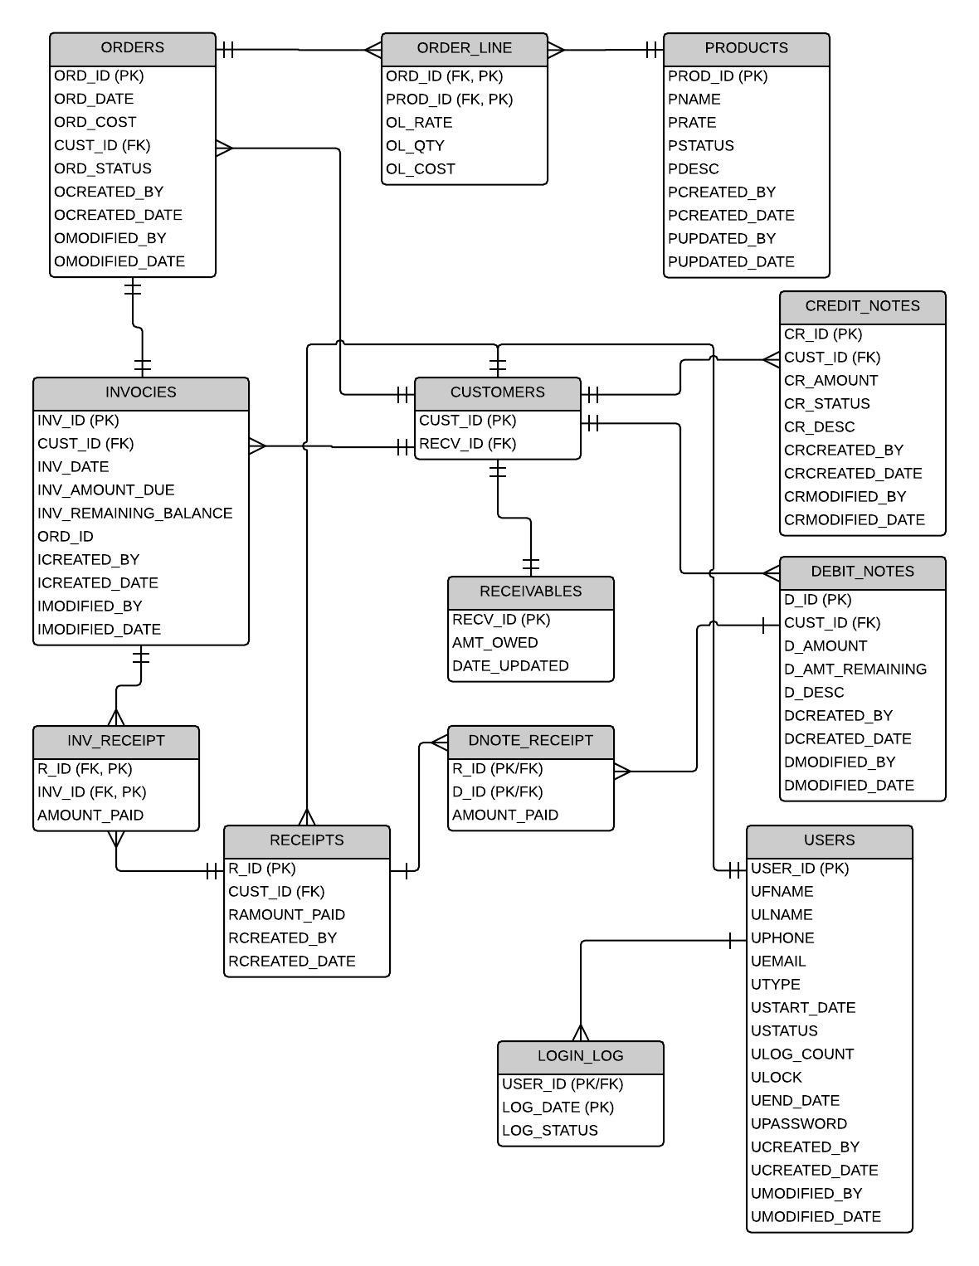
ERD

Slide 3
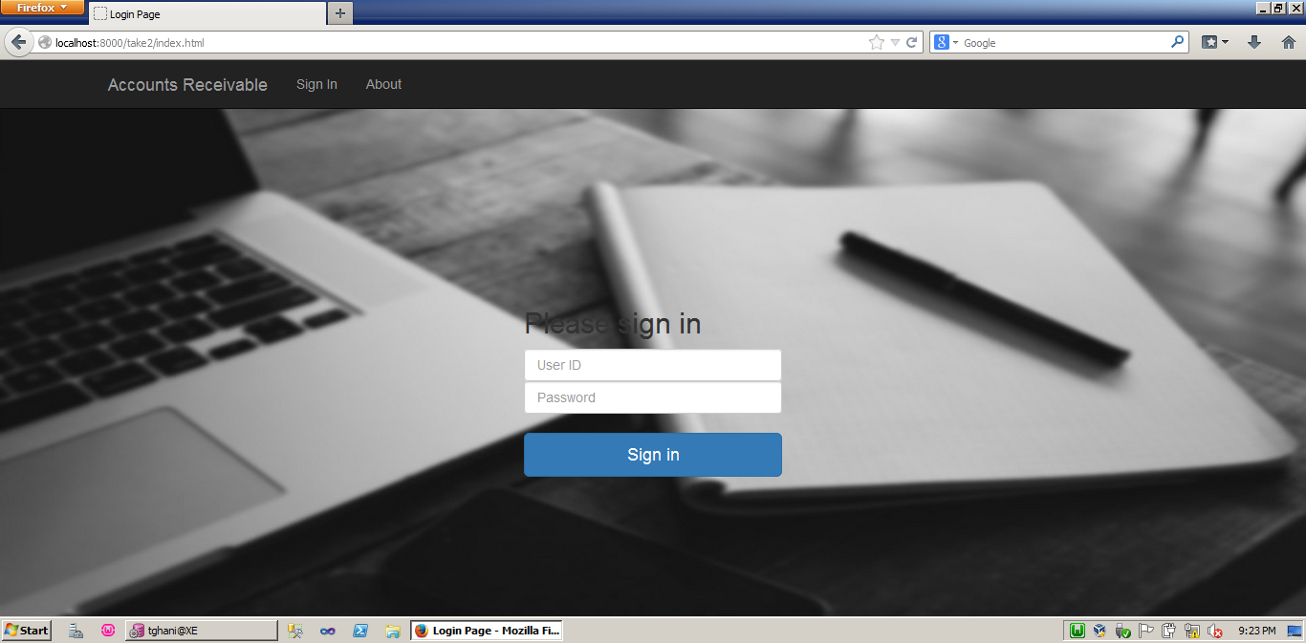

Slide 4
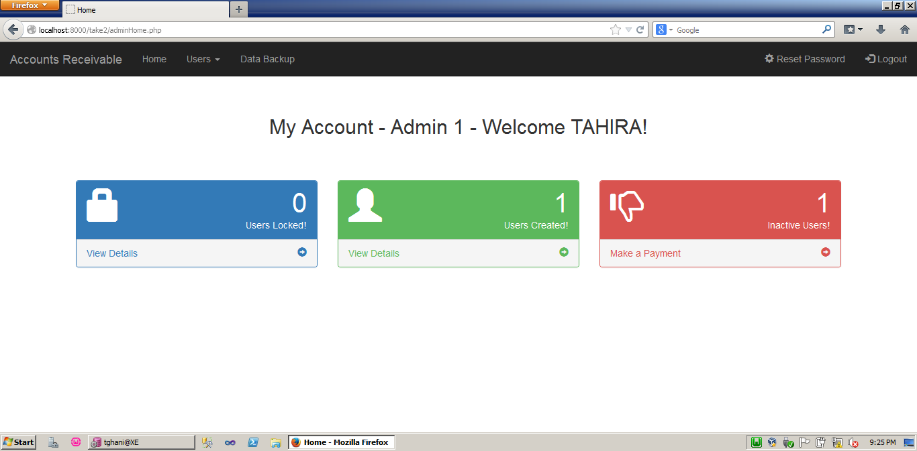
ADMIN MODULE

Slide 5
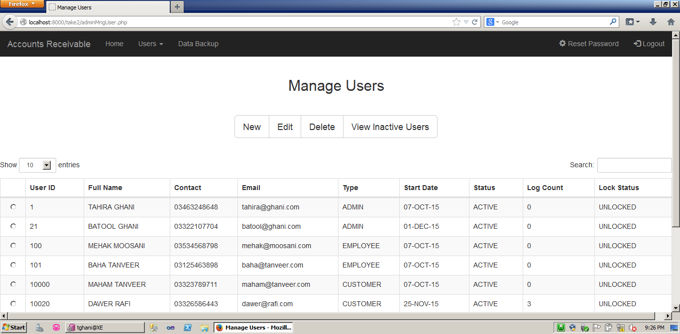
Manage Users - Admin

Slide 6
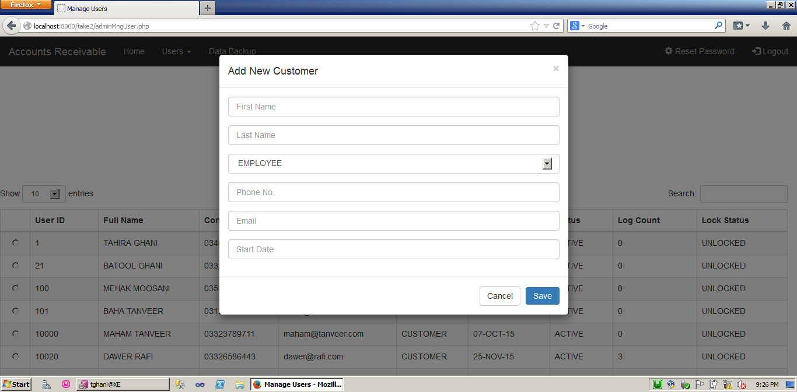
Adding New Customer - Admin

Slide 7
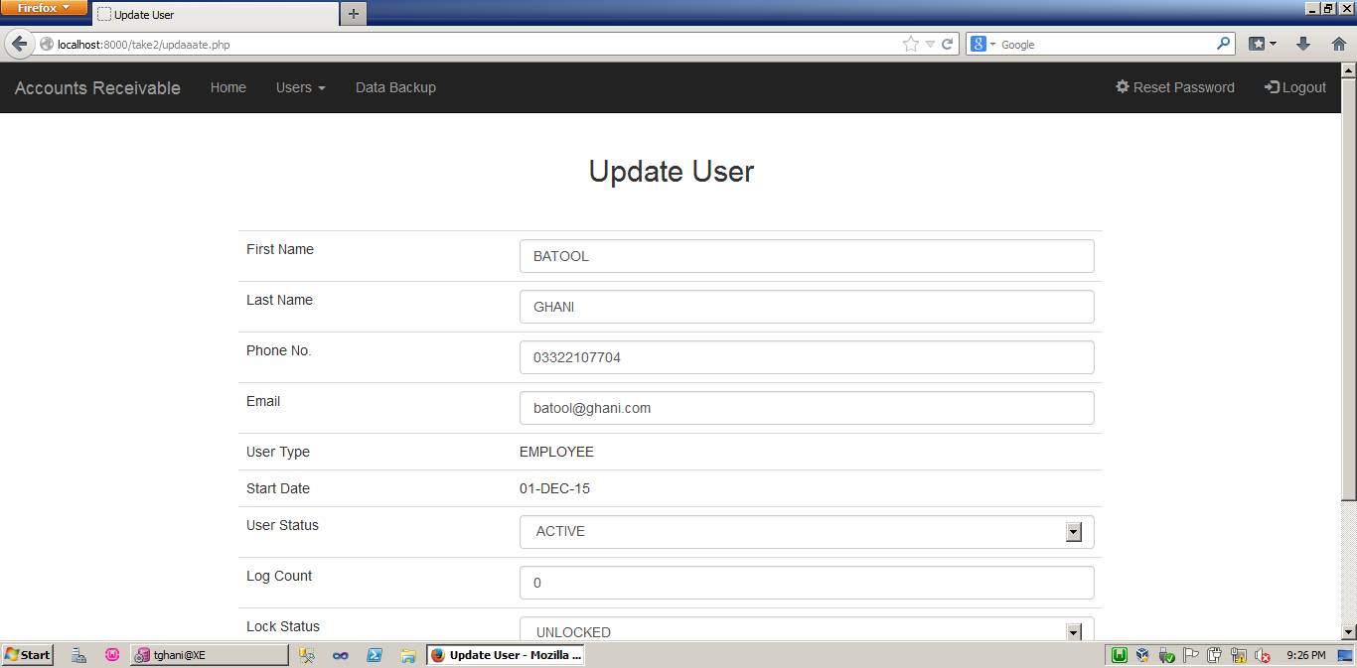
Update User - Admin

Slide 8
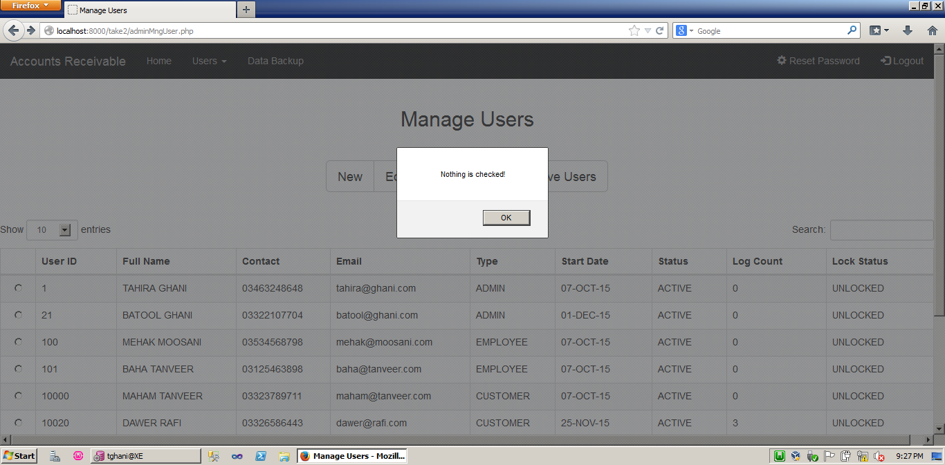
When No User is Checked

Slide 9
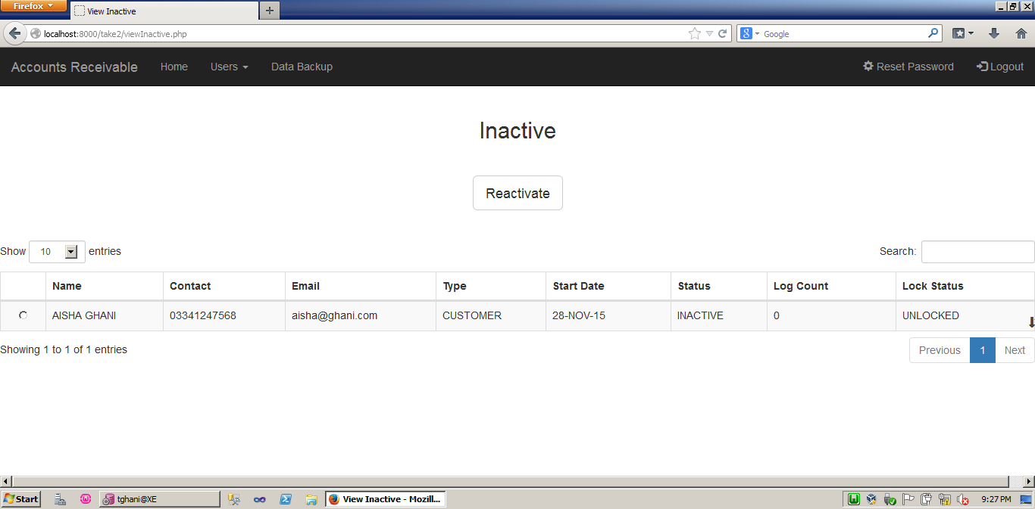
Viewing Inactive Users - Admin

Slide 10
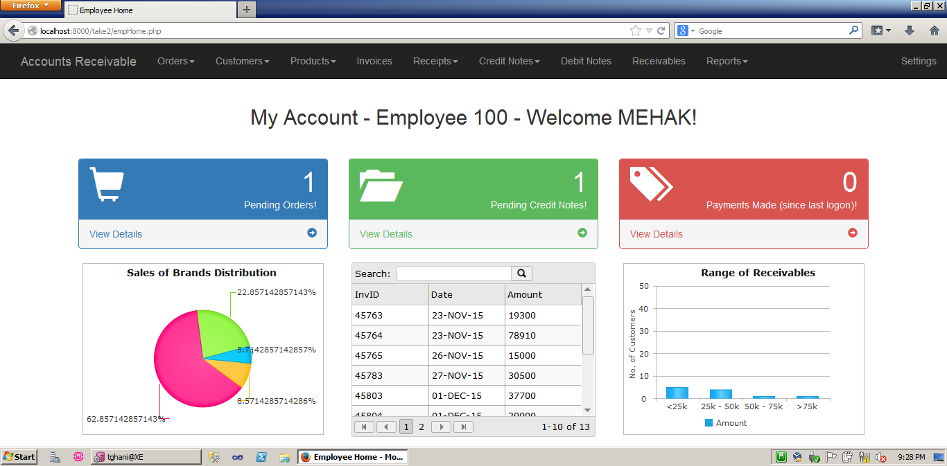
EMPLOYEE MODULE

Slide 11
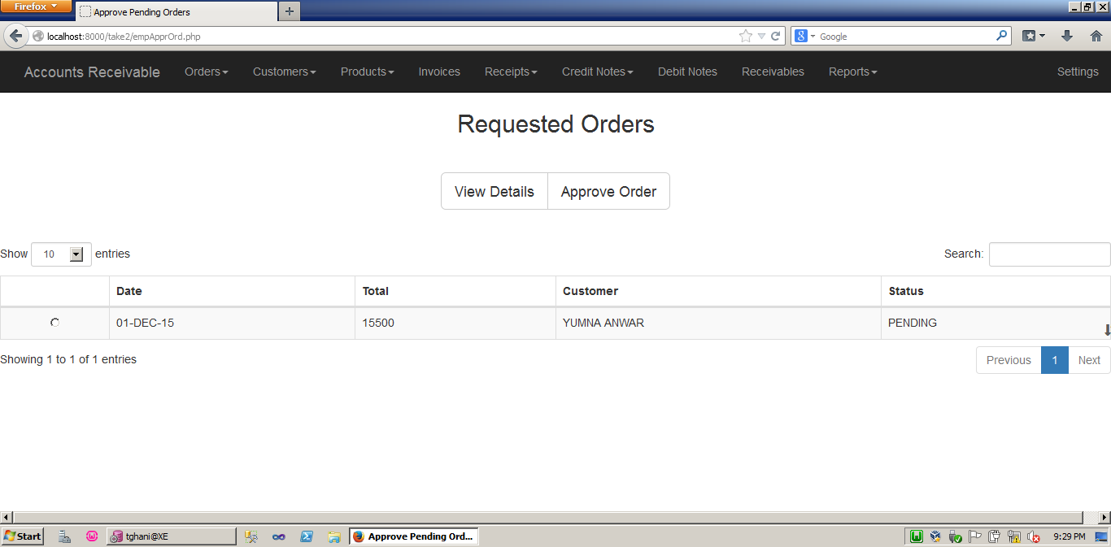
Approving Requested Orders - Employee

Slide 12
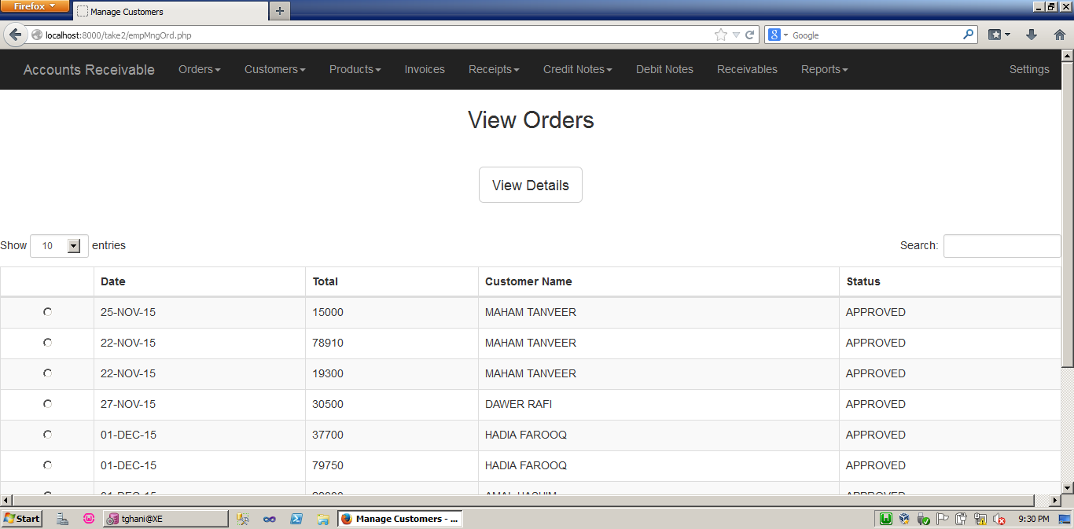
Viewing All Orders - Employee

Slide 13
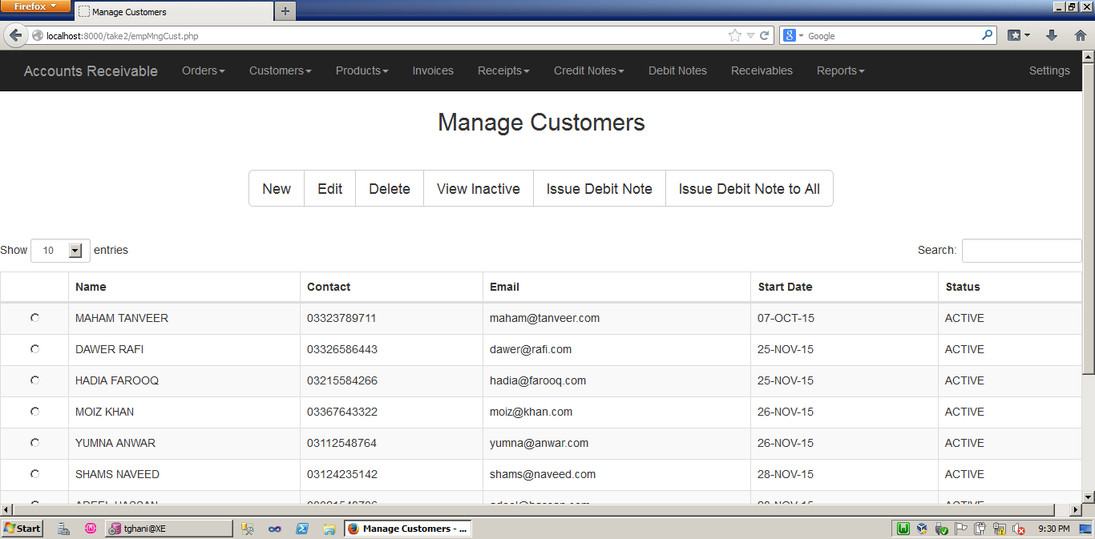
Managing Customers - Employee

Slide 14
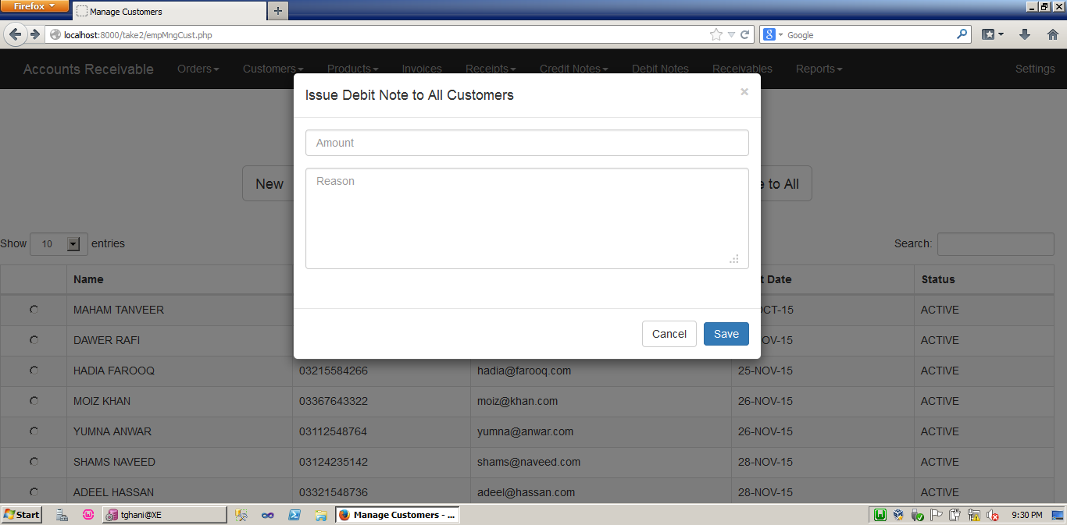
Issuing Debit Note to All Customers - Employee

Slide 15
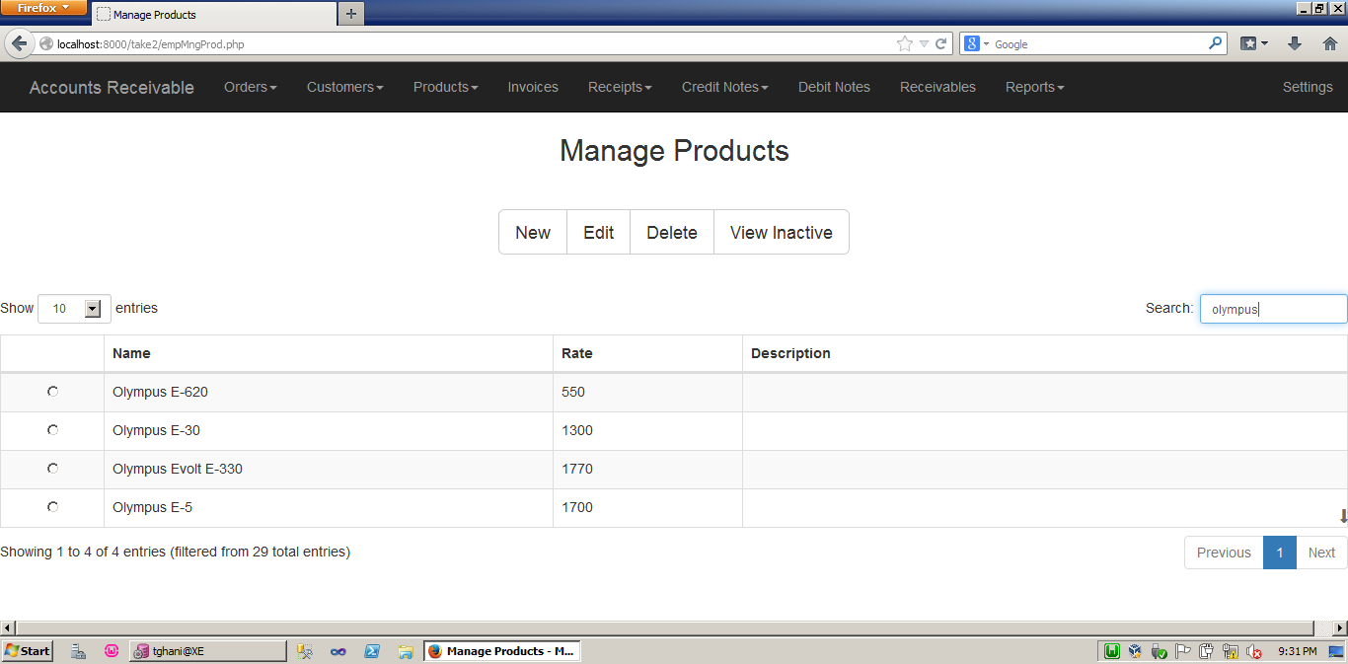
Managing Products (enter Olympus in search)

Slide 16
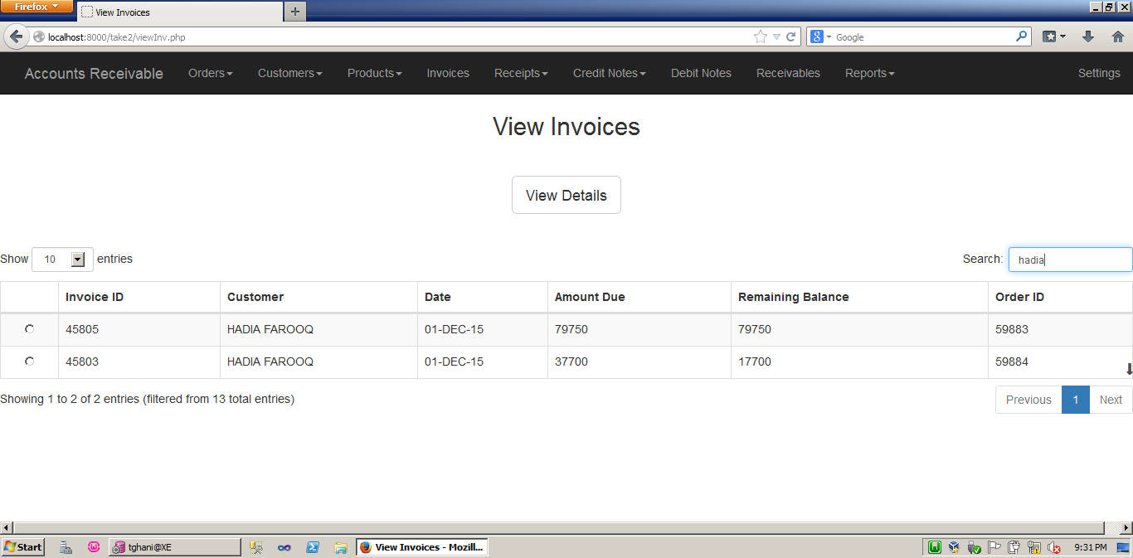
Viewing Invoices - Employee

Slide 17
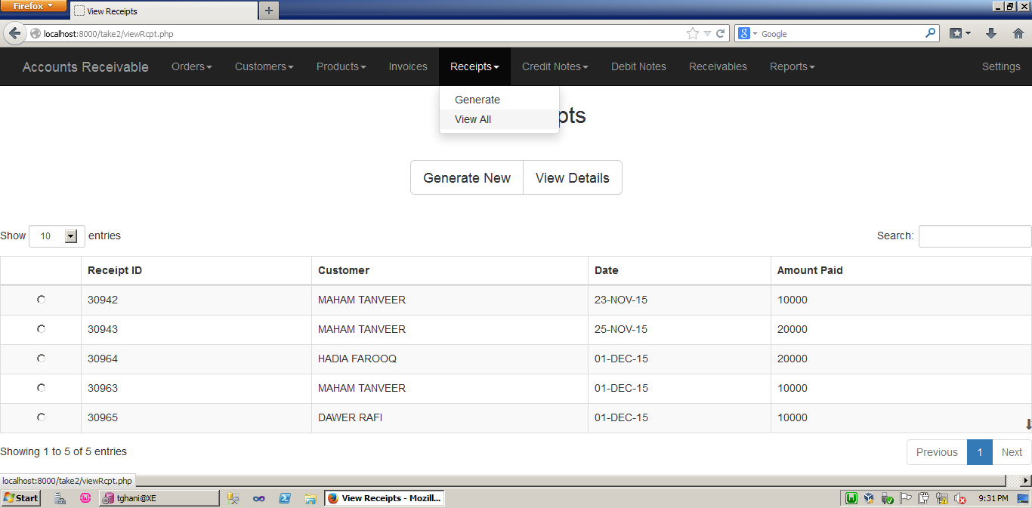
Viewing All Receipts - Employee

Slide 18
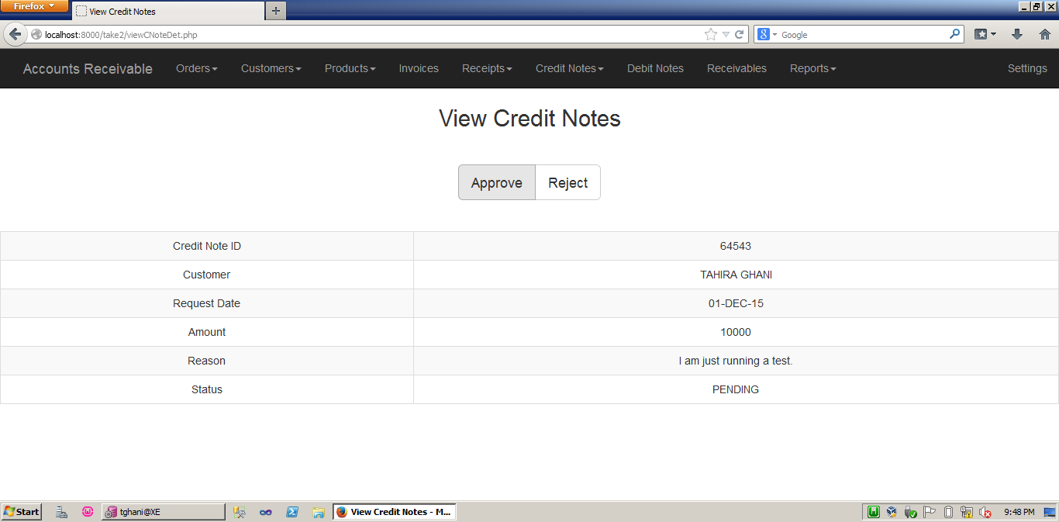
Approve/Reject Pending Credit Notes - Employee

Slide 19
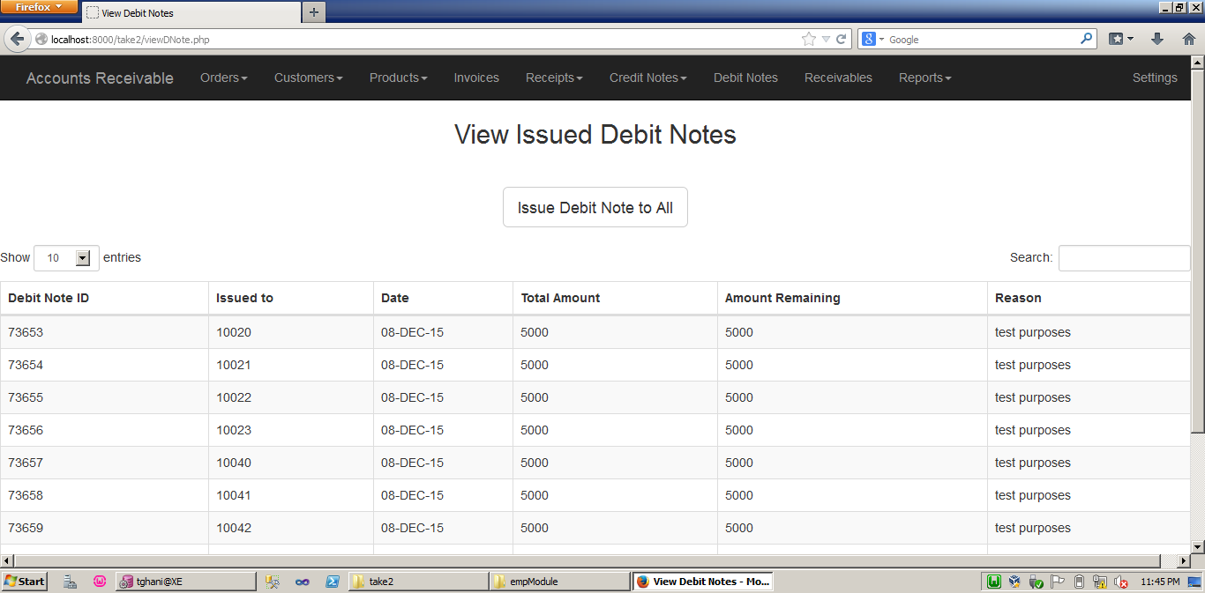
Issued Debit Notes - Employee

Slide 20
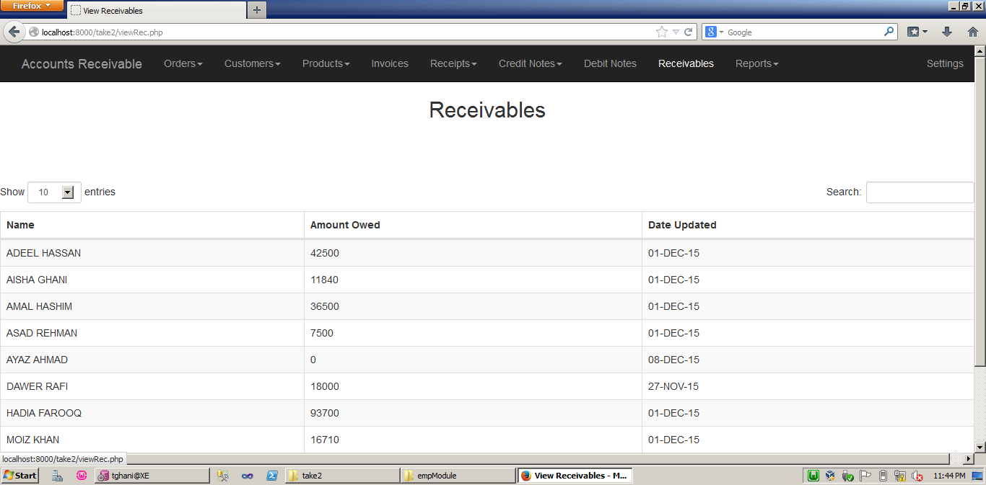
Receivables Record - Employee

Slide 21
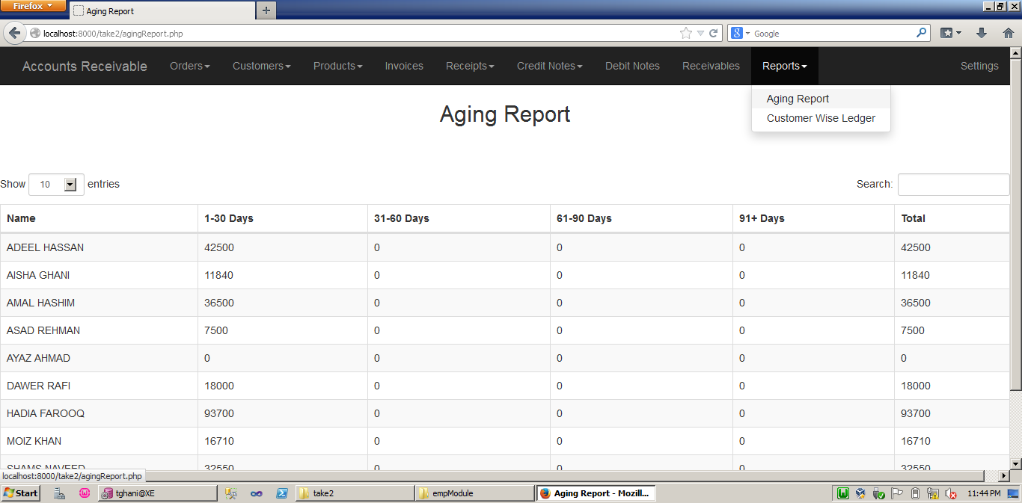
Receivables Aging Report - Employee

Slide 22
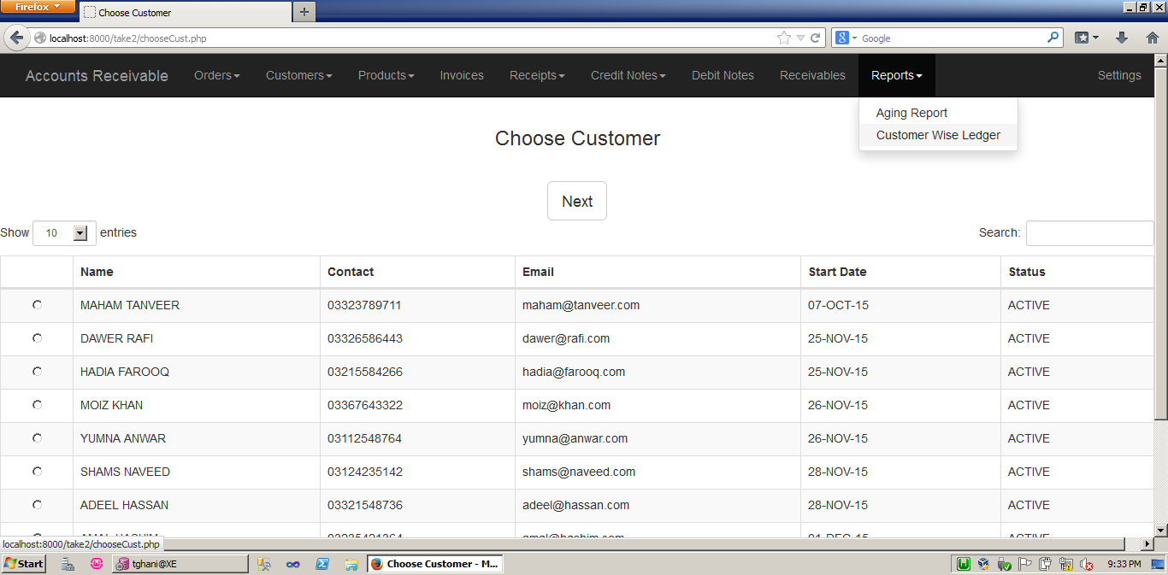
Customer Wise Ledger - Employee

Slide 23
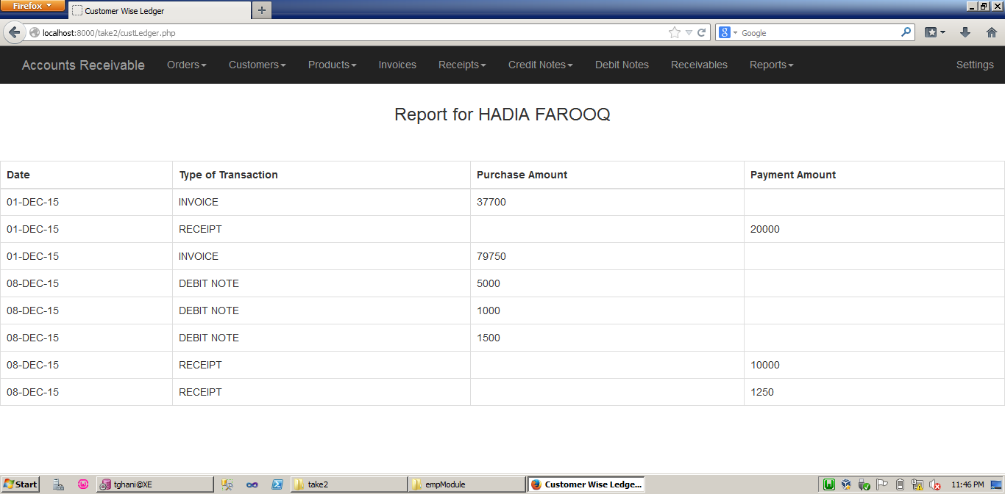
Customer Wise Ledger - Employee

Slide 24
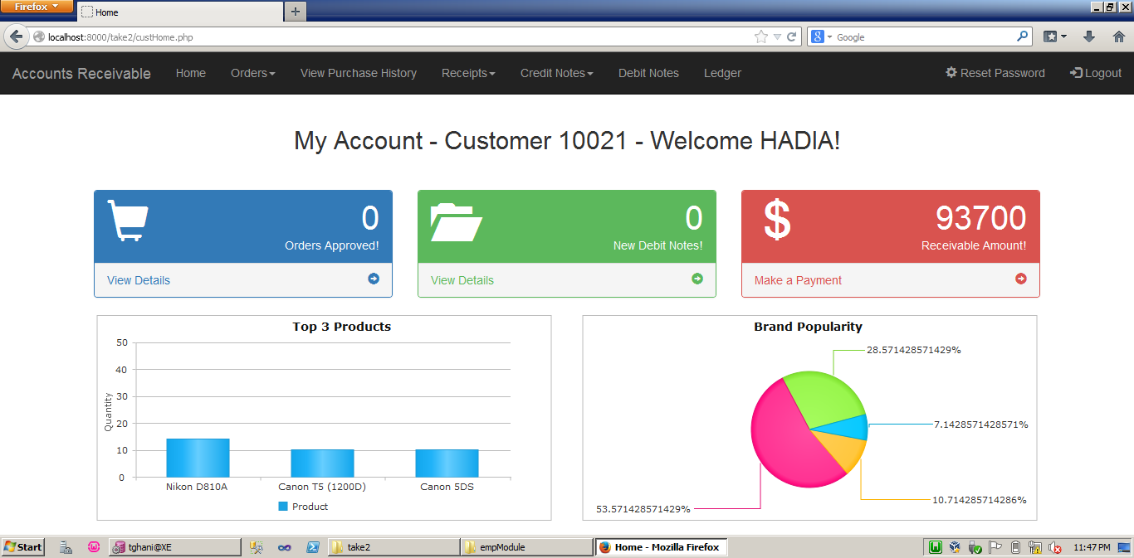
CUSTOMER MODULE

Slide 25
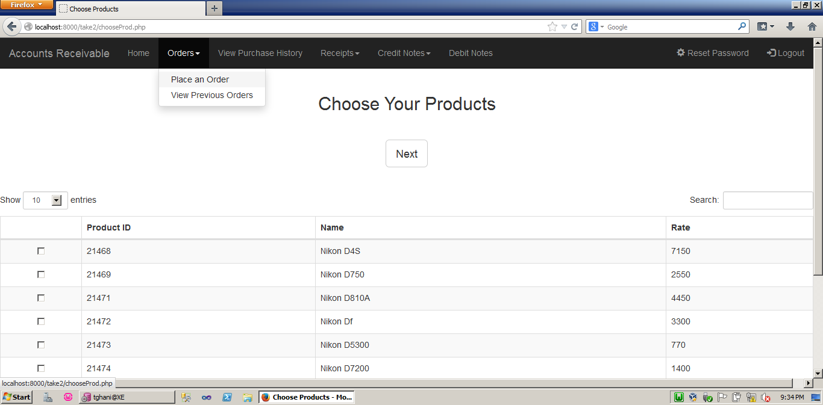
Placing an Order - Customer

Slide 26
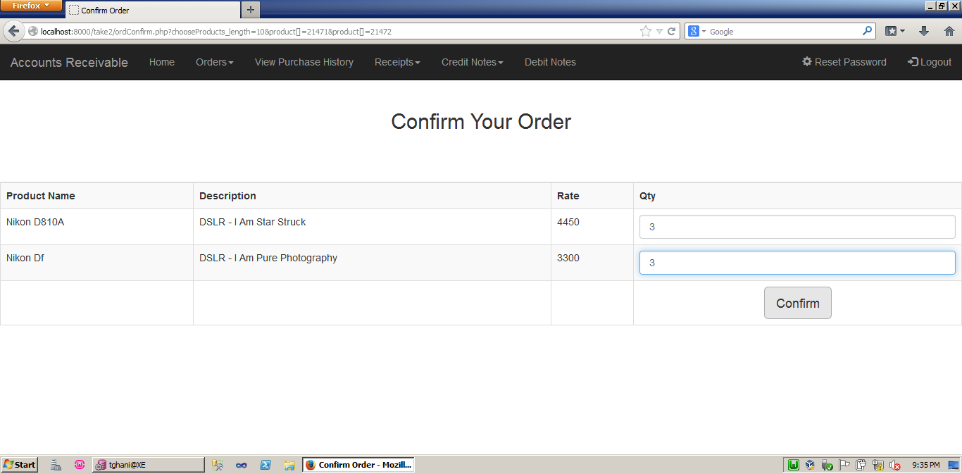
Confirming Order - Customer

Slide 27
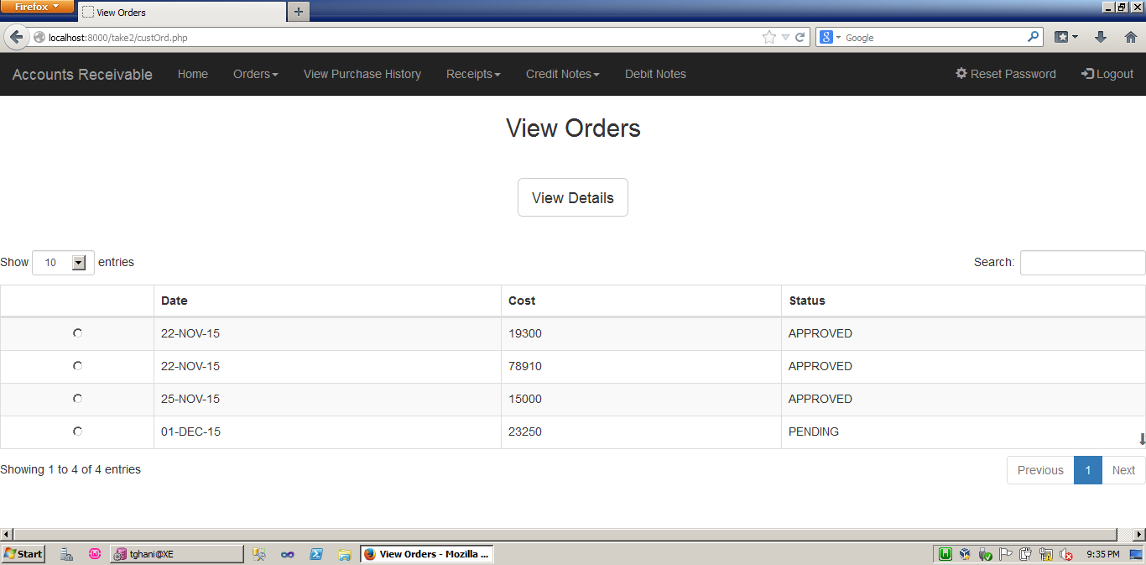
Viewing Orders - Customer

Slide 28
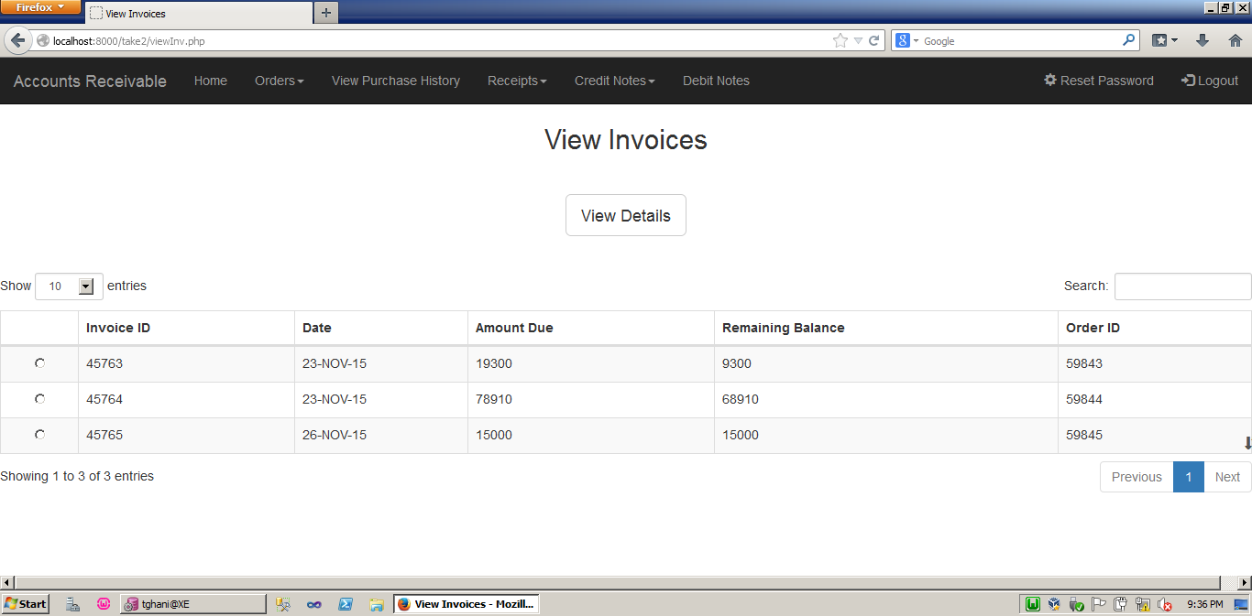
View All Invoices - Customer

Slide 29
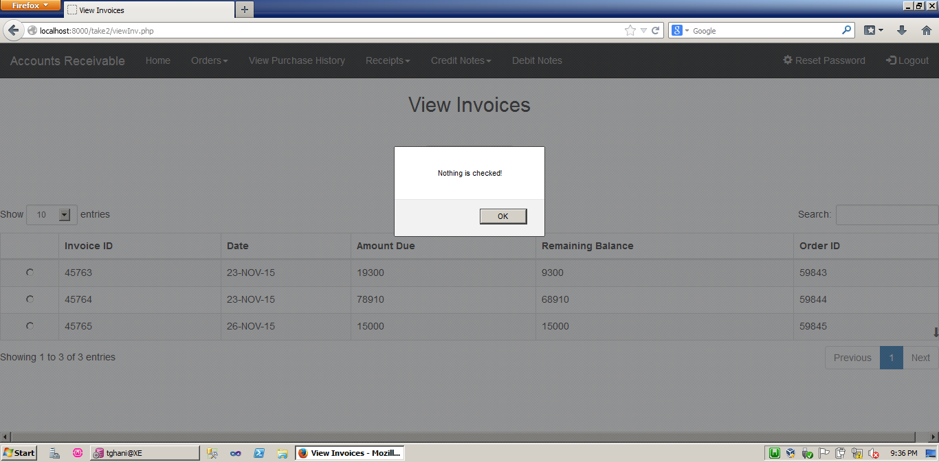
When nothing is checked - Customer

Slide 30
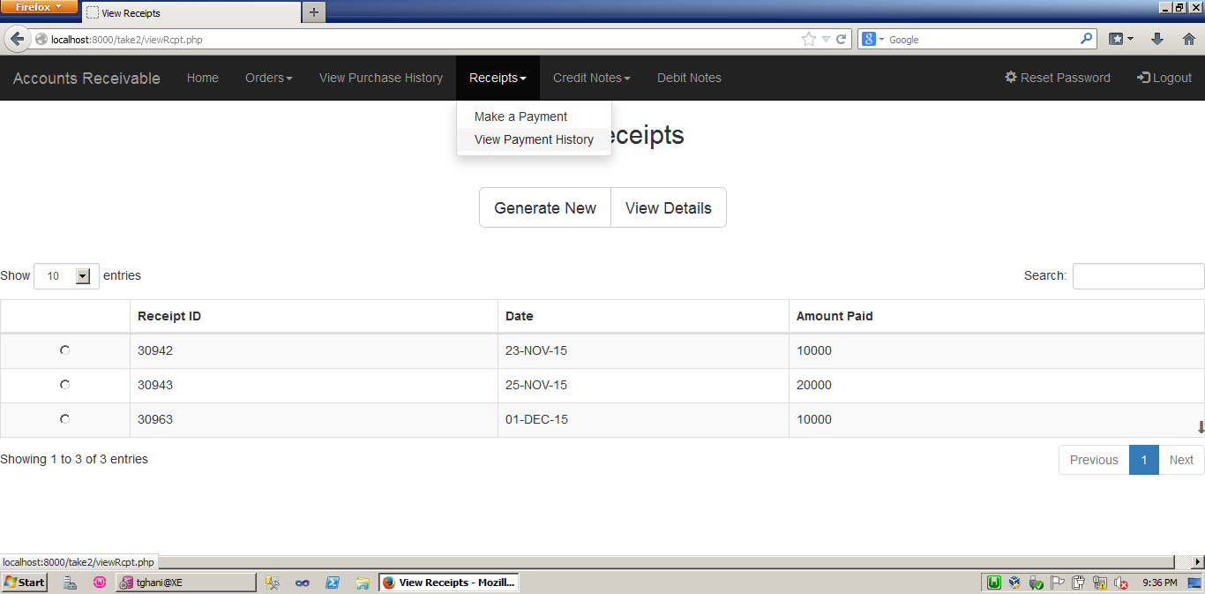
View Payment History - Customer

Slide 31
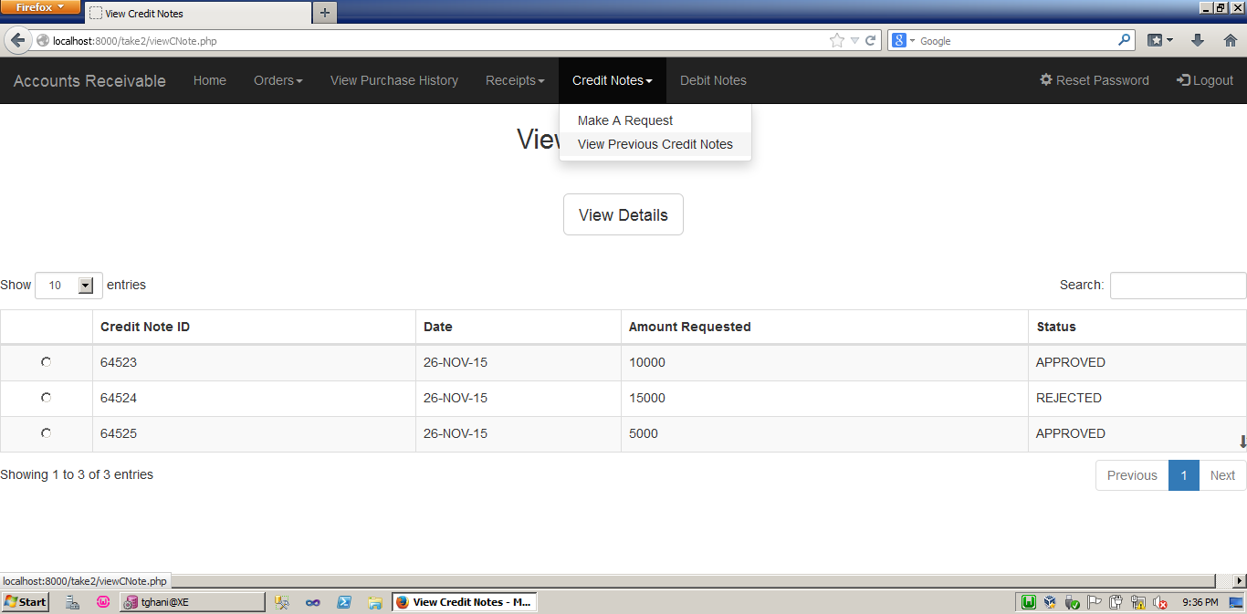
View Previous Credit Notes - Customer

Slide 32
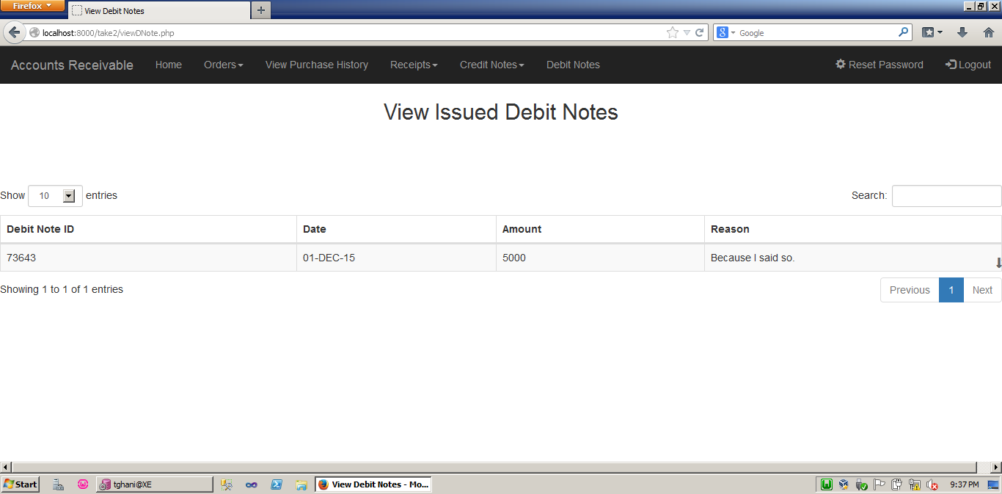
View Issued Debit Notes - Customer

Slide 33
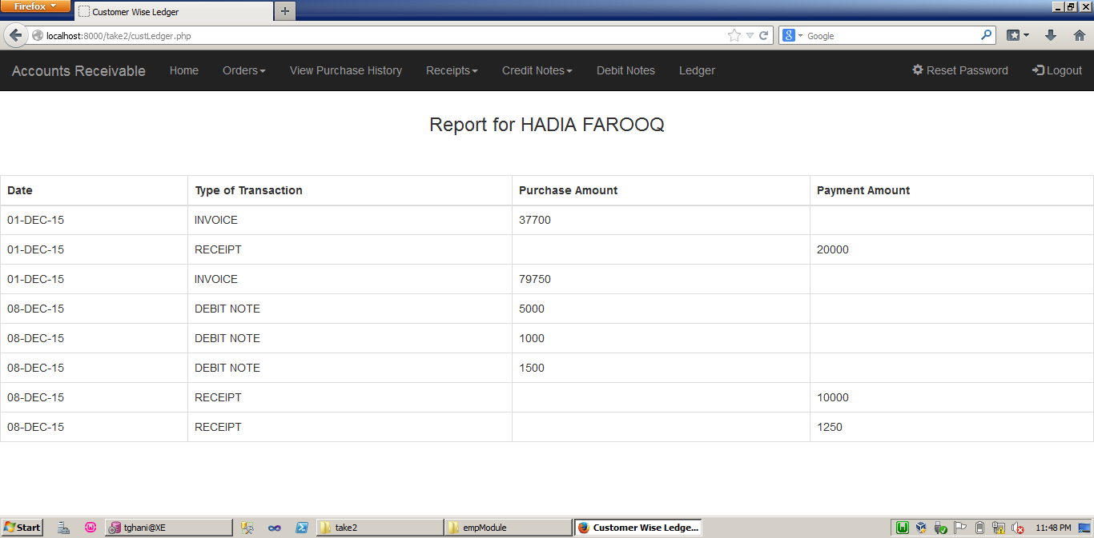
View Ledger - Customer

